Slide 1
Room Temperature Na-S Batteries
Course Instructor: Dr. Kanwar Nalwa
Presented By: Group 6
Group members:
Barkha Agarwal (200263)
Jaya Meena (200472)
Khushi Prajapati (200515)
Nawang Spalzin (200628)
Purva Bharti (200741)
Saumya Saini (200901)

Slide 2
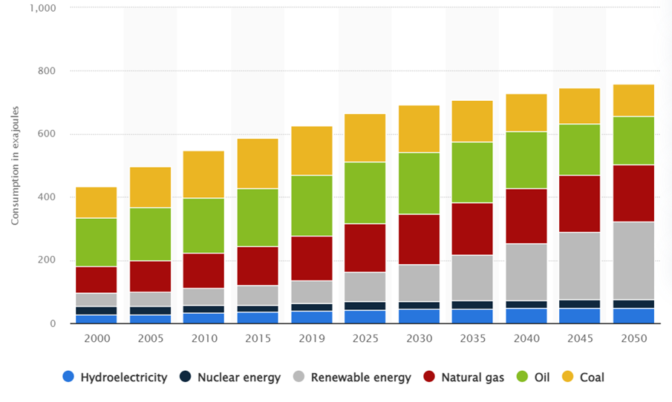
Introduction
As society progresses and natural resources become scarce, individuals must shift towards utilizing sustainable forms of energy.
To address society's energy storage demands, new batteries must have lower cost, longer cycle life, greater energy density, and power density.
Lithium-ion batteries have high cost, low energy density (100-200 Wh/kg), and poor safety performance.

Slide 3
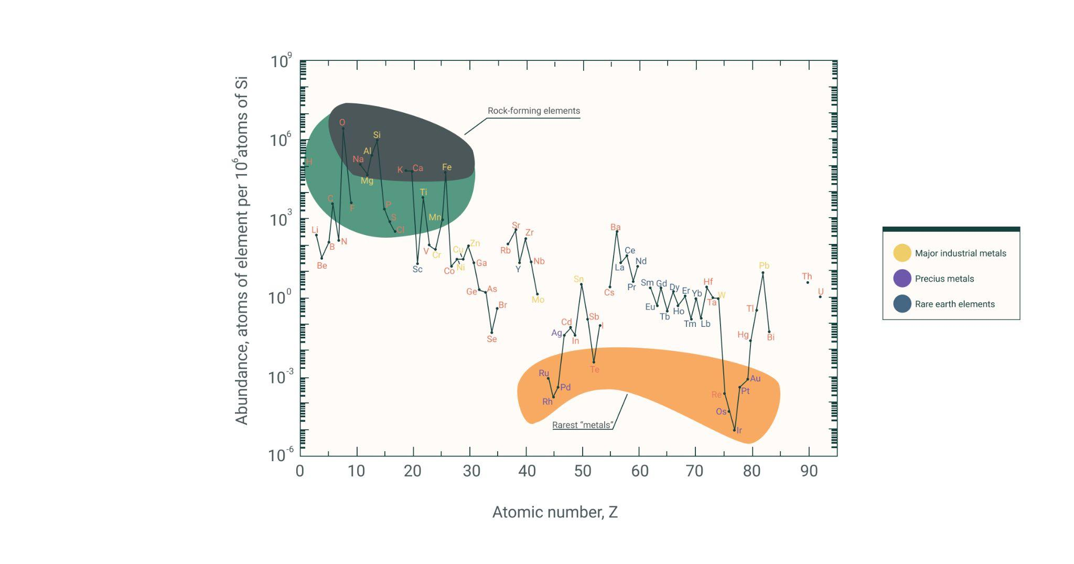
Why Na-S batteries?
Abundance and low cost
High energy density
High efficiency
Environment friendly
Notes:
In addition to that Na is environment friendly element and does not impose environmental risk as Li and S is non toxic abundant element

Slide 4
RT Na-S Battery

Slide 5
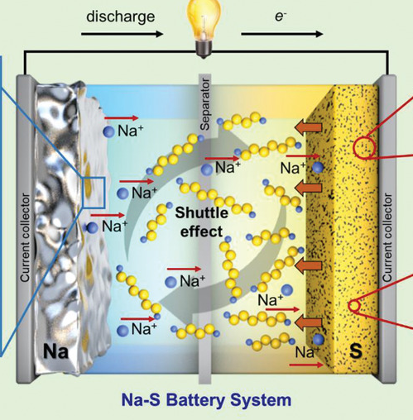
Design:
The design of room temperature Na-S batteries consists:
Na metal anode
S cathode
Electrolyte

Slide 6
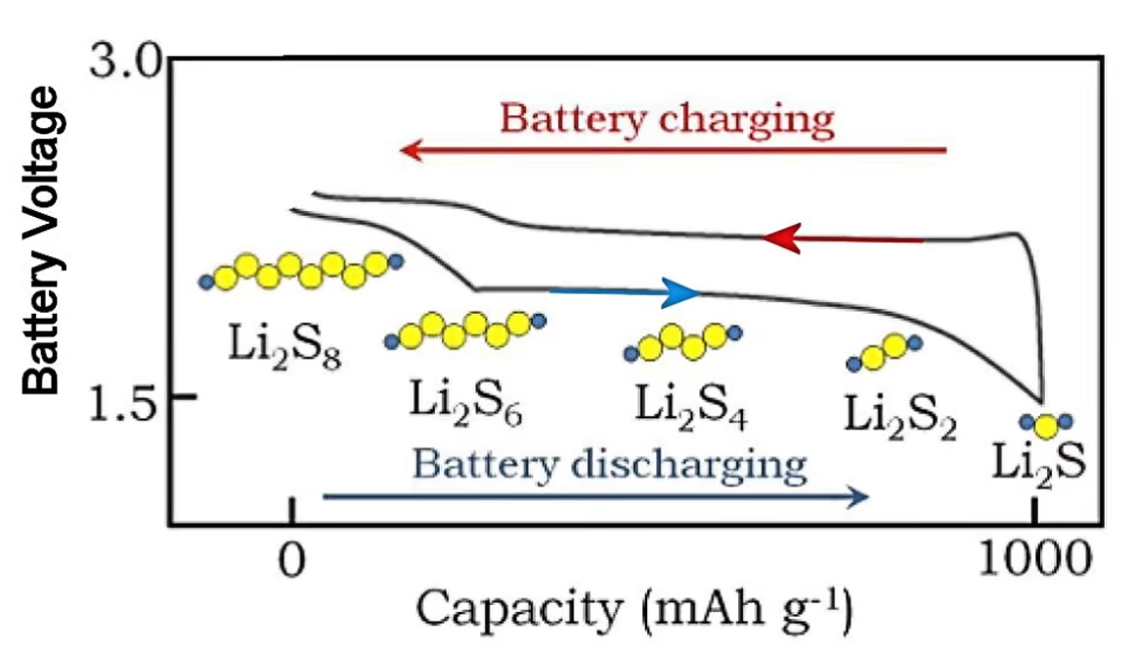
Working
During discharge, Na ions react with S (which is in the S₈ form) at the cathode to form polysulfides in the following steps:
Na ions react with S₈ to form Na₂S₈
Na₂S₈ reacts further with Na ions to form Na₂S₄
Na₂S₄ reacts further with Na ions to form Na₂S₂
Na₂S₄ reacts further with Na ions to form Na₂S

Slide 7
Working
Charging reaction of Na-S batteries involves the reverse process of the discharge reaction. It can be described in the following steps:
Na2S reacts with Na ions to form Na2S2
Na2S2 reacts further with Na ions to form Na2S4
Na2S4 reacts further with Na ions to form Na2S8
Na2S8 reacts further with S8 to form Na ions and S

Slide 8
Challenges and Strategies

Slide 9
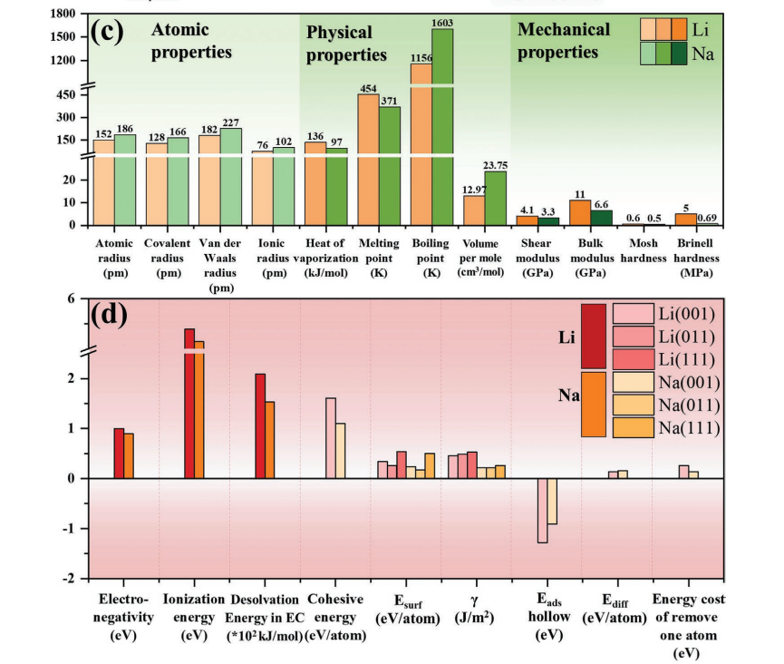
Challenges of Sodium Anode
1. Unstable dendrites
a)Low mechanical modulus
b)Low hardness of Na
c)Low surface energy
d)Lesser energy consumption removing one Na atom than Li in the electrolyte

Slide 10
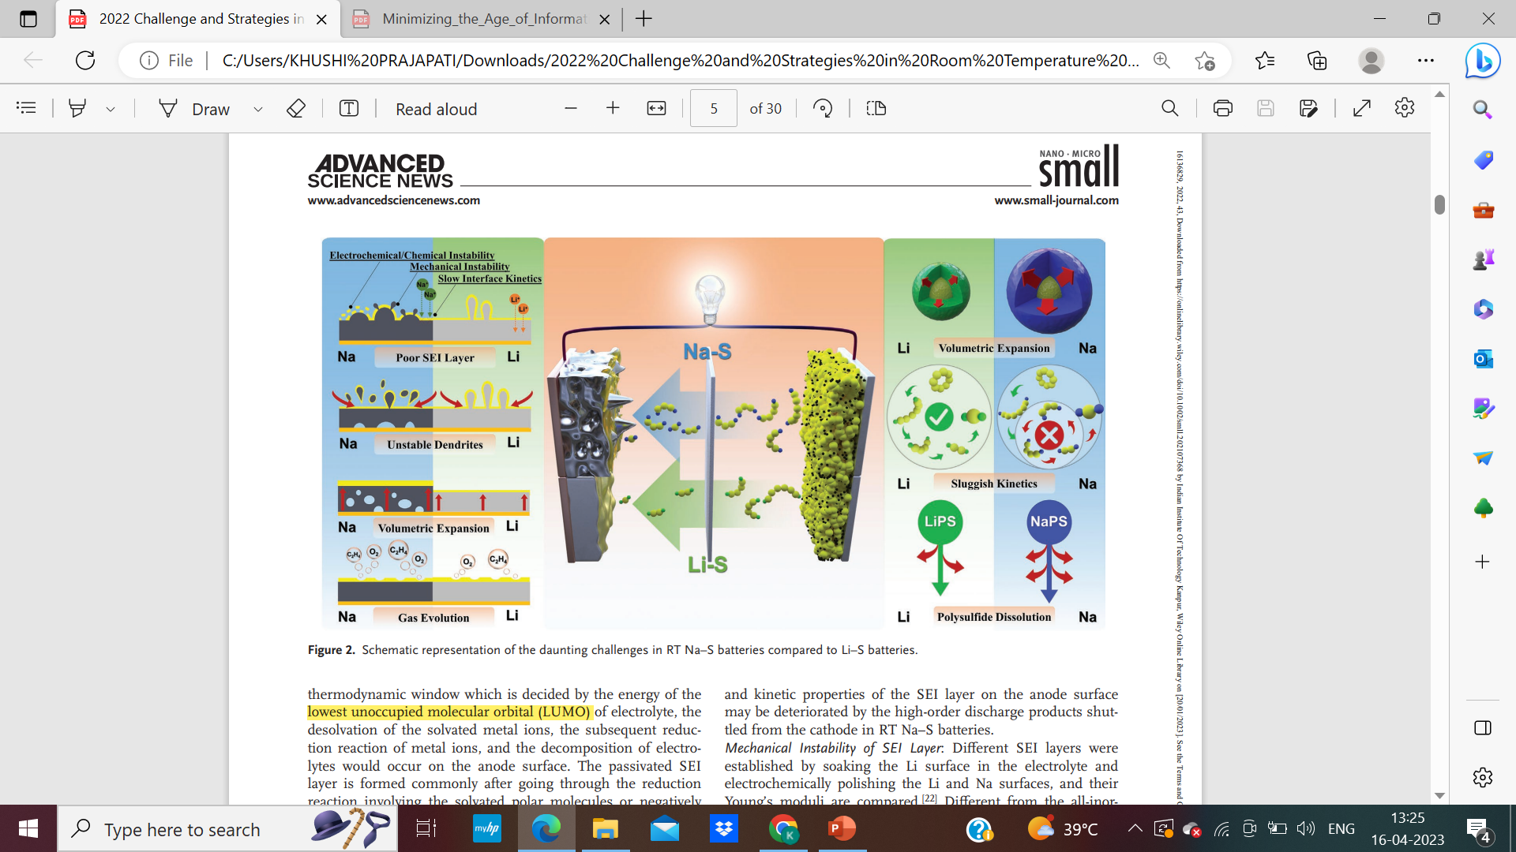
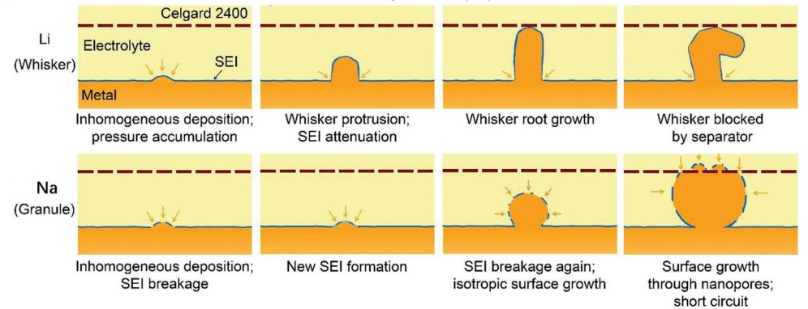
Challenges of Sodium Anode
2. Volumetric Expansion of Li and Na anodes
a)The poor SEI layer and unstable dendrites aggravate volumetric expansion.
b)The softer Na metal causes lesser squeezing for the SEI film relative to Li.
c) High internal stress

Slide 11
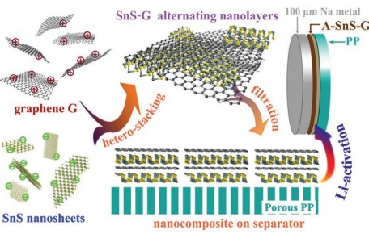
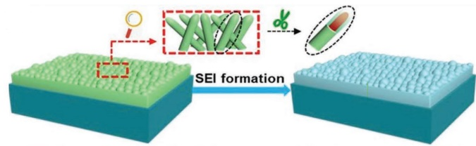
Strategy
A Li-activated SnS–graphene nanolayers containing common Li SEI components, especially LiF, and traditional Na SEI components, such as Na2O, ROCO2-Na, Na2CO3, and NaF.
The NaBi layer's increased affinity for electrolyte reduces the Na+ ion concentration gradient at the Na surface, slowing Na dendrite growth. Bi(SO3CF3)3/dimethyl ether (DME) solution

Slide 12
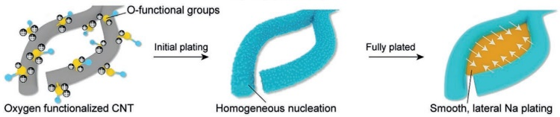
Strategy
Na fluxes grow around sodiophilic functional groups. Na grows on the Of-CNT skeleton and fills network voids, creating a dendrite-free morphology.
Sb2MoO6 microspheres can be served as seed-embedded conductive buffer matrix after the initial cycle.The Na3Sb alloy and Na-Mo-O matrix formed during cycling help to deposit sodium uniformly and without dendrite formation.

Slide 13
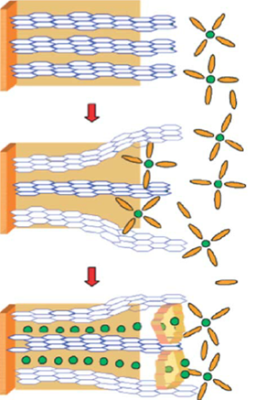
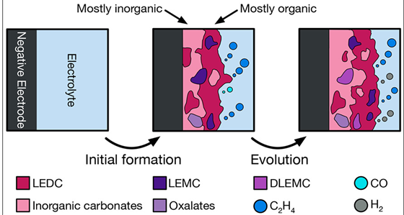
Challenge:
Low Solubility of the Solid Electrolyte Interphase (SEI) in RT NaS Batteries
•Leads to a thick SEI layer formation.
•Increased resistance
•Reduced durability and reduced cycle life

Slide 14
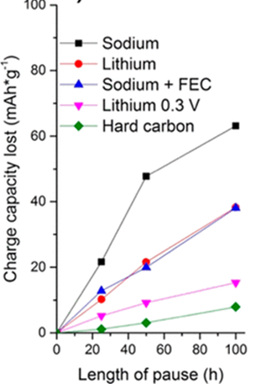
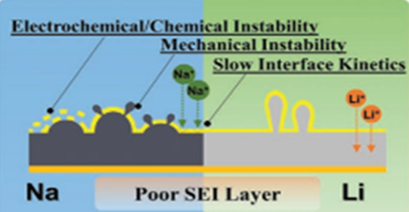
Challenge:
Low Solubility of the Solid Electrolyte Interphase (SEI) in RT NaS Batteries
•Electrochemical/Chemical Instability
•Formation of Dendrites
•Suffers a dramatic capacity loss

Slide 15
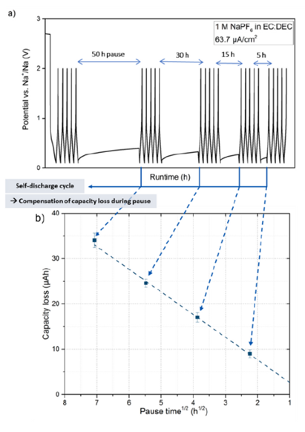
Strategy:
To Increase the Solubility of the Solid Electrolyte Interphase (SEI) in RT NaS Batteries
Limiting current density in initial cycles of battery can aid in forming a stable and soluble SEI.
To rejuvenate a battery with a thick SEI layer, it may be cycled through charge and discharge cycles to break down the layer.
Optimizing electrode materials' composition and morphology can improve the stability of SEI formation in RT NaS batteries.

Slide 16
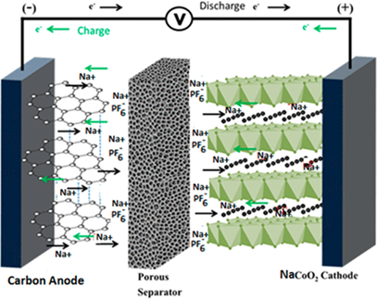
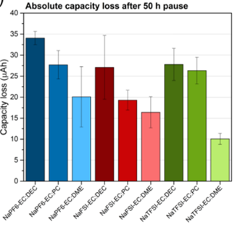
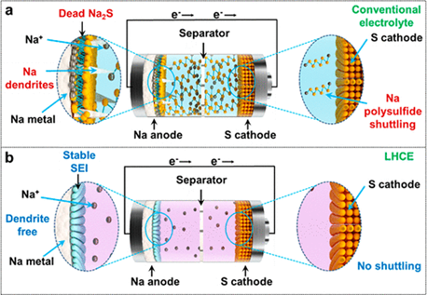
Strategy:
To Increase the Solubility of the Solid Electrolyte Interphase (SEI) in RT NaS Batteries
To optimize SEI in batteries add salts like NaTFSI or NaPF6 to increase solubility and cycling stability
Addition of co-solvents or additives like sulfolane, DME, or LiDFOB improves solubility of SEI by enhancing SEI dissolution and increases capacity.
Addition of LHCE rather than HCE or other electrolytes can stablise the SEI.

Slide 17
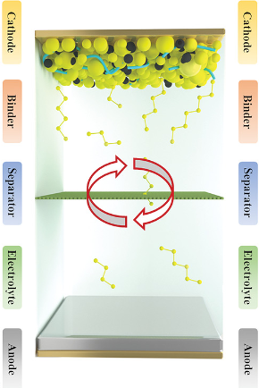
Shuttle phenomenon in Liquid Electrolyte in RT Na-S Batteries
Intermediate species→high & low order NaPSs, long-chain NaPSs are easily dissolved into LE
They migrate from the cathode→anode,
→corrode Na metal & form solid deposits SluggishKinetics
→block the flow of ions and electrons
Self Discharge
Na highly reactive so, Na and PSs rxn is more vigorous thus more shuttle effect→low efficiency & rapid capacity decay during cycling

Slide 18
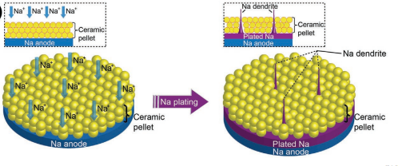
Strategies :
Na-β″–Al2O3 SSEs:
no Shuttling Effect
mechanical and physical barrier
no liquid leakage so battery safety
high Na+ ion conductivity
no formation of soluble NaPSs
BUT!! suffer from:
Dendrites form through the grain boundaries
mechanically brittle

Slide 19
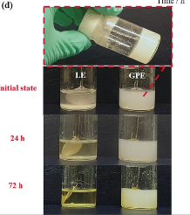
Switch to GPE :
high viscosity of GPEs suppress the dissolution of PS
avoid Electrolyte leakage → LE trapped inside the polymer matrix
high mech strength→no Na metal dendrite formation, no internal SC
high ionic conductivity
Extremely stable cycling (2500 cyc),discharge capacity 600mAhgs−1 at 2C and an average CE of 99.91%

Slide 20
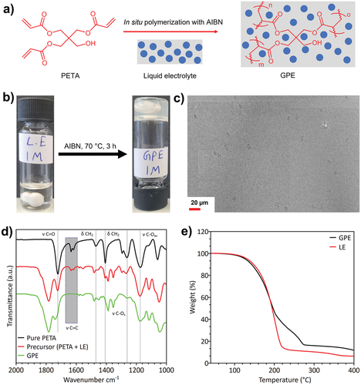
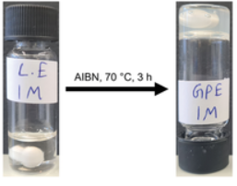
GPE synthesis
synthesized by free radical polymerization of a precursor solution containing PETA and LE using AIBN as a thermal initiator at 70°C
LE sol (1M Na tetraphenylborate (C6H5)4BNa, propylene carbonate C4H6O3 and 7wt% FEC fluoroethylene carbonate C3H3FO3)
PETA : pentaerythritol triacrylate C14H18O7
AIBN : azobisisobutyronitrile C8H12N4

Slide 21
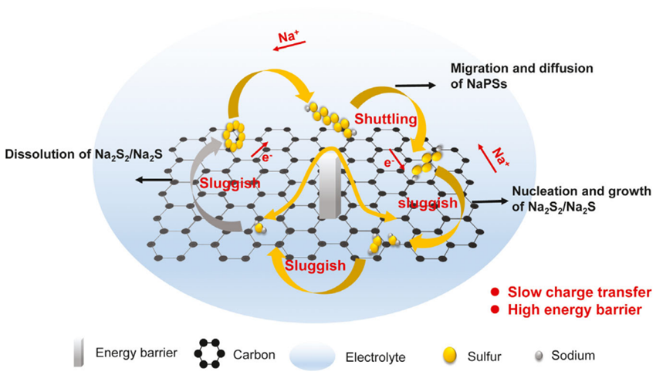
Accumulation of Na₂S_{x} on the cathode leading to Slow Reaction rate and High internal Resistance
The discharge process in Na-S battery can be roughly divided into following 4 stages:
Solid–Liquid : The solid S obtains e- and combines with Na+ to form long-chain Na₂S_{x}. This involves charge transfer.
Liquid–Liquid : Long-chain Na₂S_{x} are reduced to Na₂S₄, they can dissolve in electrolyte(main process of shuttle effect).
Liquid–Solid : The conversion kinetic of soluble Na₂S₄ to insoluble Na₂S₂/Na₂S is sluggish due to high energy barrier. Dissolution of Na₂S_{x} increases viscosity of electrolyte leading to internal resistance & slow reaction kinetics.
Solid–Solid : Reduction in solid Na₂S₂ to solid Na₂S is mainly charge transfer process. But, difficult to occur due to inherent insulation of Na₂S₂/Na₂S.
The kinetic issues and influence factors of reaction rate in RT Na-S battery

Slide 22
Approach towards the solution
Catalysts can be used in the S cathode, to accelerate the conversion of Na₂S_{x} by enhanced charge transfer and lowered energy barrier.
The reduced soluble Na₂S_{x} are adsorbed by catalytic sites and are reduced to insoluble Na₂S quickly and also the catalytic sites could guide the uniform deposition of Na₂S.
The design principle of catalytic materials as S host includes:
High conductivity, accelerating movement of e- & promoting conversion of Na₂S_{x}
High adsorption and catalytic property
High specific surface area, providing sufficient active sites for Na₂S_{x}

Slide 23
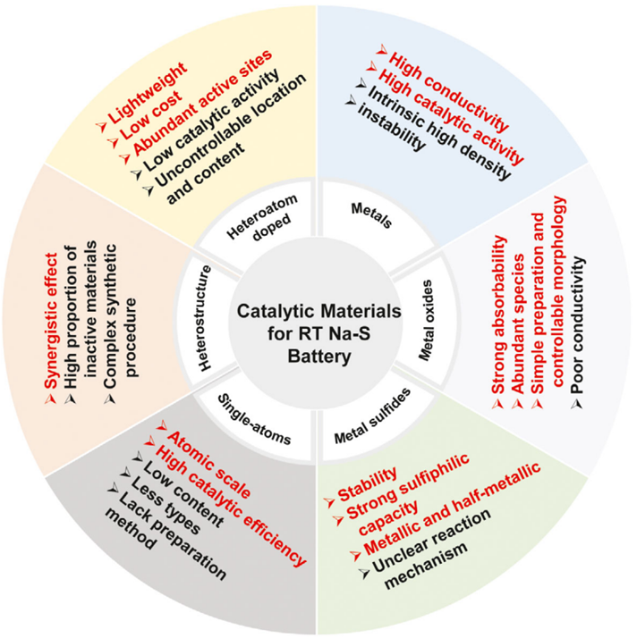
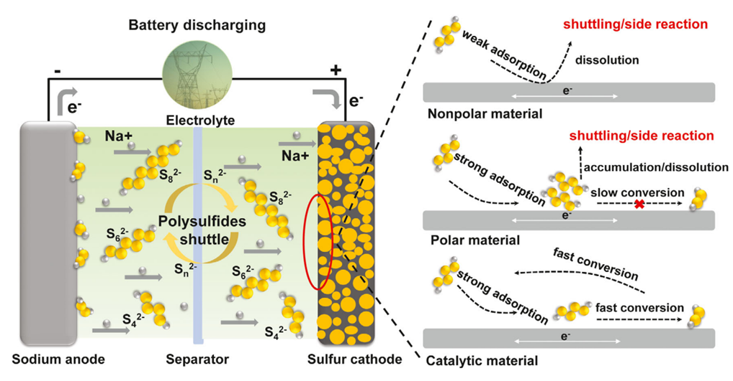
More about catalytic material
Schematic representation of RT Na-S battery
The synergistic effect of adsorption and catalysis of catalytic materials
Advantages and limitations of various catalytic materials

Slide 24
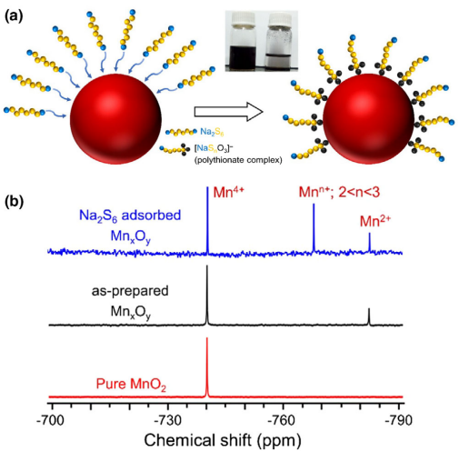
Metal Oxides as catalytic material
Benefits:
Low cost, abundant species, simple preparation.
It makes strong polar interaction with Na₂S_{x} because of Oxygen anion.
Metal oxides can occur surface redox reaction with Na₂S_{x} to form thiosulfate/polythionate, which chemically anchor the polysulfides and enhance the redox reaction.
The strong adsorption capacity of metal oxides can effectively relieve migration of NaPSs and side reaction, meanwhile, catalyzing the redox of NaPSs.
Drawbacks:
The poor conductivity of metal oxides increases the internal resistance, which is not conductive to the interface transmission of electrons, leading to sluggish reaction kinetics and low utilization of active materials.
Many metal oxides with strong sulfophilic property can also be used as the sulfur host to improve the performance, although they cannot undergo redox reactions with polysulfides.

Slide 25
Performance Analysis:
Good cycling stability
Low environmental impact
Cheap
Operate at ambient temperature
Effective alternative of ZEBRA batteries
typical temperature of 270°C–350°C
continuous operation
parasitic load

Slide 26
Performance Analysis:
Low energy and power densities, limiting their use in grid-scale energy storage applications.
Na–S battery is considered as one of the most promising candidates for GLEES. (Grid-Level Large-Scale Electrical Energy Storage) tackling the problem of limited energy density and short cycle life as is witnessed in case of Lead-Acid Batteries.
Potential applications in stationary energy storage systems for small-scale residential or commercial use.

Slide 27
Conclusions And Perspectives:
● Potential alternative to Li-S batteries due to the low cost and abundance of sodium.
● But there is a lack of proper R&D for manufacturing processes
● Additionally, advancements in battery management systems and integration with renewable energy sources can enhance the flexibility and reliability of these batteries in energy storage applications.

Slide 28
Cost Analysis:
Anode: 150 grams of Sodium
Cost = $1 USD per pound of sodium,
- Cost of sodium per gram = $1 USD per pound / 453.59 grams per pound = $0.0022 USD per gram
- Cost of sodium per 1 kWh battery = 150 grams of sodium x $0.0022 USD per gram = $0.33 USD per battery
Cathode: Sulfur - 200 grams
Assuming a cost of $0.50 USD per pound of sulfur
- Cost of sulfur per gram = $0.50 USD per pound / 453.59 grams per pound = $0.0011 USD per gram
- Cost of sulfur per 1 kWh battery = 200 grams of sulfur x $0.0011 USD per gram = $0.22 USD per battery

Slide 29
Cost Analysis:
Catalyst : Manganese oxide
Price of 99.9% ranges from $8 to $30 USD per kilogram. Assuming a catalyst loading of 5% by weight in the battery.
- 50 grams of manganese oxide is needed for a 1 kWh battery (5% of 1 kg)
- The cost of manganese oxide for a 1 kWh NaS battery = 50 grams x ($8/1000) = $0.4 USD per battery
Electrolyte:: PETA gel polymer electrolyte
Price range : $200 to $500 per kilogram
Assuming 5% weight fraction of the PETA gel polymer electrolyte in the battery:
- For $200 per kilogram --> 50 grams of PETA gel polymer electrolyte is needed.
The cost of PETA gel polymer electrolyte for a 1 kWh battery = 50 grams x ($200/1000) = $10 USD per battery.

Slide 30
Cost Analysis:
Estimated manufacturing cost of each component of the battery per kWh is as follows:
- Anode (carbon-based material): $50-100 USD/kWh
- Cathode (sulfur-based material and catalyst): $400-$800 USD/kWh
- Electrolyte (sodium polysulfide solution): $1-2 USD/kWh
- Separator (ceramic material): $10-20 USD/kWh
- Current collectors (copper and aluminum): $10-20 USD/kWh
Based on the above cost estimations, the total manufacturing cost of a room temperature NaS battery for 1 kWh can be roughly estimated to be between $471 to $1,542 USD/kWh.

Slide 31
Cost Analysis:
Total Material Cost = 10.95 $/KWH battery
Manufacturing Cost = 471 $/KWH battery
Total Cost = 481.95 $/KWH battery
Comparative with the cost of High temperature NaS batteries being $300-500 per KWH battery

Slide 32
Thank You!

